Slide 1
Smart device sensors programing
Assistant : Simonas Česnauskas

Slide 2
The purpose of the subject
The main goal is to acquaint with the design of a smart device and the programming of its components.

Slide 3
The structure of the subject
Introduction to electronics. Basic knowledge of electronics and acquaintance with components;
Programming of data entry components;
Programming of data output components.

Slide 4
Lab works
In total we will have 10 practical lectures;
8 planned laboratory works;
2 laboratory work defenses;
We will do what we can with distance learning;
We will do as much as we can.

Slide 5
Settlements
We will have 2 colloquia;
We will have 2 laboratory work defenses;
We will have a final report, an exam.

Slide 6
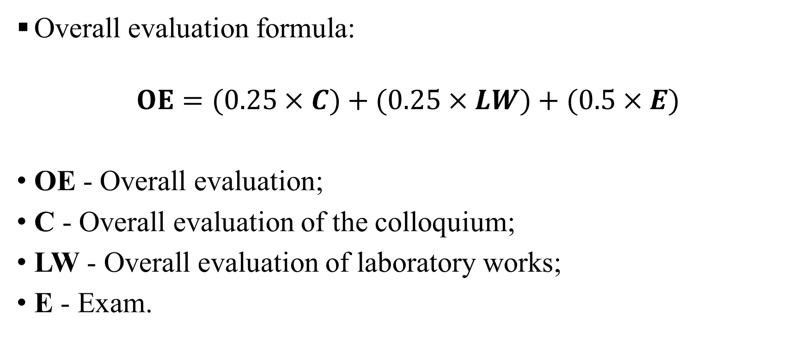
Overall evaluation
Overall evaluation formula:
$$OE=(0.25×C)+(0.25×LW)+(0.5×E)$$
OE - Overall evaluation;
C - Overall evaluation of the colloquium;
LW - Overall evaluation of laboratory works;
E - Exam.

Slide 7
Goodbye

